Slide 1

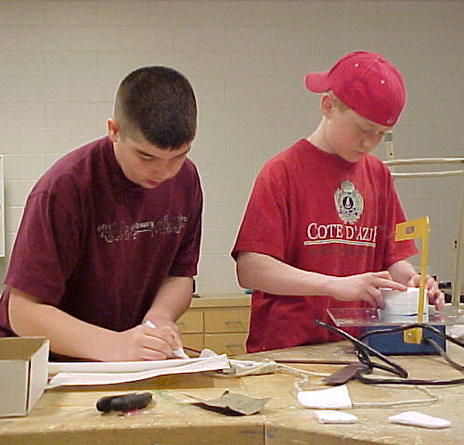
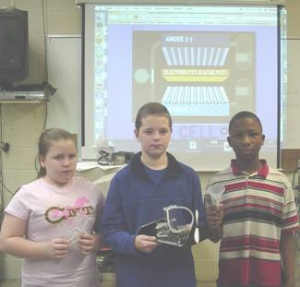




Advanced Design Applications
Creativity Engagement
Teacher Resource – Day 5.1
© 2014 International Technology and Engineering Educators Association
STEMCenter for Teaching and Learning™
Advanced Design Applications
Notes:
© International Technology Education Assoc
Slide #<number>
12/01/2009
STEMCenter for Teaching & Learning™ Engineering byDesign™

Slide 2

The BIG Idea
Big Idea:
Creativity is a major factor in creating inventions and developing innovations.
© 2014 International Technology and Engineering Educators Association
STEMCenter for Teaching and Learning™
Advanced Design Applications
Notes:
[Authors: Please include teacher notes appropriately.]
© International Technology Education Assoc
Slide #<number>
12/01/2009
STEMCenter for Teaching & Learning™ Engineering byDesign™

Slide 3
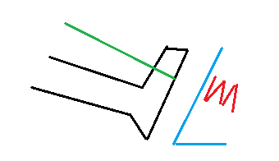
The Engineering Design Journal
Take a look at the following picture. There is foot that is over a gas pedal in a car. The foot is suspended by a band (because of an injury).
What happens to the
foot when the band is
removed?
© 2014 International Technology and Engineering Educators Association
STEMCenter for Teaching and Learning™
Advanced Design Applications
Notes:
[Authors: Please include teacher notes appropriately.]
© International Technology Education Assoc
Slide #<number>
12/01/2009
STEMCenter for Teaching & Learning™ Engineering byDesign™

Slide 4
The Engineering Design Journal
The correct answer will depend on the force in the foot.
© 2014 International Technology and Engineering Educators Association
STEMCenter for Teaching and Learning™
Advanced Design Applications
Notes:
[Authors: Please include teacher notes appropriately.]
© International Technology Education Assoc
Slide #<number>
12/01/2009
STEMCenter for Teaching & Learning™ Engineering byDesign™

Slide 5
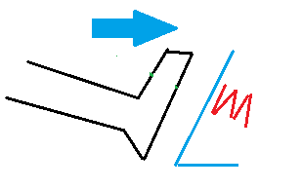
The Engineering Design Journal
If the foot is pushing against the band, the foot will move down to touch the pedal after the band is removed. If the car is running, it will accelerate.
© 2014 International Technology and Engineering Educators Association
STEMCenter for Teaching and Learning™
Advanced Design Applications
Notes:
[Authors: Please include teacher notes appropriately.]
© International Technology Education Assoc
Slide #<number>
12/01/2009
STEMCenter for Teaching & Learning™ Engineering byDesign™

Slide 6
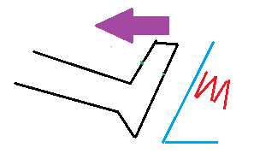
The Engineering Design Journal
If the foot is pulling away from the band, the foot will continue to move up after the band is removed and move farther from the pedal. The car will not accelerate.
© 2014 International Technology and Engineering Educators Association
STEMCenter for Teaching and Learning™
Advanced Design Applications
Notes:
[Authors: Please include teacher notes appropriately.]
© International Technology Education Assoc
Slide #<number>
12/01/2009
STEMCenter for Teaching & Learning™ Engineering byDesign™

Slide 7
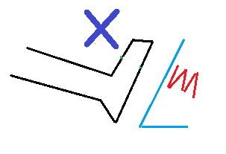
The Engineering Design Journal
If there is no force in the foot when the band is removed, the foot will not move and the pedal will not be depressed. The car will not accelerate
© 2014 International Technology and Engineering Educators Association
STEMCenter for Teaching and Learning™
Advanced Design Applications
Notes:
[Authors: Please include teacher notes appropriately.]
© International Technology Education Assoc
Slide #<number>
12/01/2009
STEMCenter for Teaching & Learning™ Engineering byDesign™

Slide 8
Why We Explore
The most common answer is that the foot will touch the pedal: this is actually suitable for most situations.
This test shows how easy it is to give the most obvious answer and thus ignore possible alternatives.
© 2014 International Technology and Engineering Educators Association
STEMCenter for Teaching and Learning™
Advanced Design Applications
Notes:
[Authors: Please include teacher notes appropriately.]
© International Technology Education Assoc
Slide #<number>
12/01/2009
STEMCenter for Teaching & Learning™ Engineering byDesign™

